Slide 1
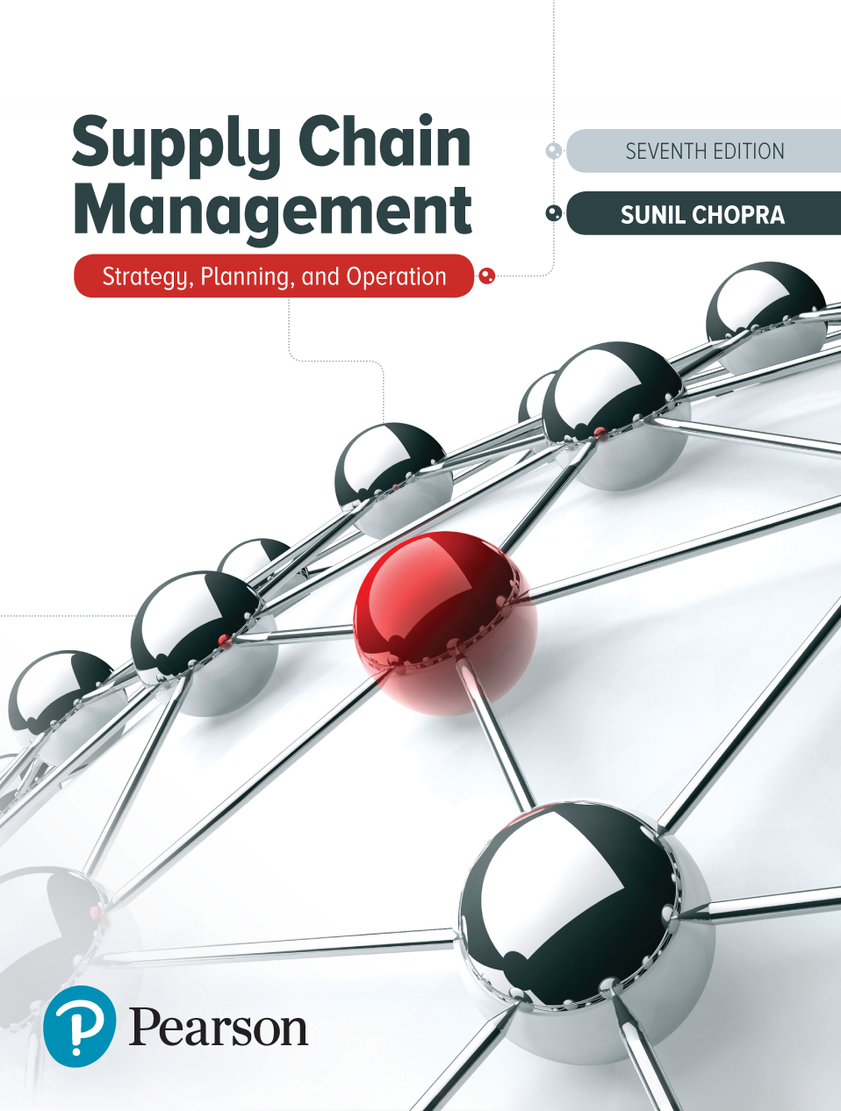
Supply Chain Management: Strategy, Planning, and Operation
Seventh Edition
Chapter 14
Transportation in a Supply Chain
Copyright © 2019, 2016, 2013 Pearson Education, Inc. All Rights Reserved
Notes:
If this PowerPoint presentation contains mathematical equations, you may need to check that your computer has the following installed:
1) MathType Plugin
2) Math Player (free versions available)
3) NVDA Reader (free versions available)

Slide 2
Learning Objectives (1 of 2)
14.1 Understand the role of different transportation modes in a supply chain.
14.2 Discuss the role of infrastructure and policies in transportation.
14.3 Identify the relative strengths and weaknesses of various transportation network design options.
14.4 Understand some success factors in a responsive network for same day delivery.

Slide 3
Learning Objectives (2 of 2)
14.5 Evaluate trade-offs that shippers need to consider when designing a transportation network.
14.6 Design tailored transportation networks in a supply chain.

Slide 4
Transportation Modes and Their Role in a Supply Chain
Movement of product from one location to another
Products rarely produced and consumed in the same location
Significant cost component
Shipper requires the movement of the product
Carrier moves or transports the product

Slide 5
Modes of Transportation and Their Performance Characteristics (1 of 2)
Air
Package carriers
Truck
Rail
Water
Pipeline
Intermodal

Slide 6
Modes of Transportation and Their Performance Characteristics (2 of 2)
Table 14-1 Transportation Facts
Mode | Freight Value ($ billions) in 2011 | Freight Tons (millions) in 2011 | Freight Ton-Miles (billions) in 2011 | Value Added to G N P ($ billions) in 2009
Air (includes truck and air) | 394 | 6 | 11 | 61.9
Truck | 12,181 | 11,924 | 2,337 | 113.1
Rail | 588 | 2,053 | 1,518 | 30.8
Water | 201 | 645 | 434 | 14.3
Pipeline | 889 | 1,912 | 1,018 | 12.0
Multimodal | 1,985 | 583 | 489 | Blank
Notes:
Notes:

Slide 7
Air
Cost components
Fixed infrastructure and equipment
Labor and fuel
Variable depending on passenger/cargo
Key issues
Location/number of hubs
Fleet assignment
Maintenance schedules
Crew scheduling
Prices and availability

Slide 8
Package Carriers
Small packages up to about 150 pounds
Expensive
Rapid and reliable delivery
Small and time-sensitive shipments
Provide other value-added services
Consolidation of shipments a key factor

Slide 9
Truck
Significant fraction of the goods moved
Truckload (T L)
Low fixed cost
Imbalance between flows
Less than truckload (L T L)
Small lots
Hub and spoke system
May take longer than T L
Fatigue-related accidents
Notes:
Notes:

Slide 10
Rail
Move commodities over large distances
High fixed costs in equipment and facilities
Scheduled to maximize utilization
Transportation time can be long
Trains ‘built’ not scheduled
Notes:
Notes:

Slide 11
Water
Limited to certain geographic areas
Ocean, inland waterway system, coastal waters
Very large loads at very low cost
Slowest
Dominant in global trade
Containers

Slide 12
Pipeline
High fixed cost
Primarily for crude petroleum, refined petroleum products, natural gas
Best for large and stable flows
Pricing structure encourages use for predicable component of demand

Slide 13
Intermodal
Use of more than one mode of transportation to move a shipment
Grown considerably with increased use of containers
May be the only option for global trade
More convenient for shippers – one entity
Key issue – exchange of information to facilitate transfer between different modes

Slide 14
Summary of Learning Objective 1 (1 of 2)
Transportation decisions affect supply chain profitability and influence both inventory and facility decisions within a supply chain. The various modes of transportation include water, rail, truck, air, pipeline, intermodal, and package carriers. Water is typically the least expensive mode but is also the slowest, whereas air and package carriers are the most expensive and the fastest. Rail and water are best suited for low-value, large shipments that do not need to be moved in a hurry.

Slide 15
Summary of Learning Objective 1 (2 of 2)
Air and package carriers are best suited for small, high-value, emergency shipments. Intermodal and T L carriers are faster than rail and water but are somewhat more expensive. L T L carriers are best suited for small shipments that are too large for package carriers but much smaller than needed for a T L.

Slide 16
Transportation Infrastructure and Policies (1 of 2)
Governments generally take full responsibility or played a significant role in building and managing infrastructure elements
Without a monopoly, deregulation and market forces help create an effective industry structure
Pricing should reflect the marginal impact on the cost to society

Slide 17
Transportation Infrastructure and Policies (2 of 2)
Figure 14-1 Impact of Average And Marginal Cost on Vehicle Flow

Slide 18
Summary of Learning Objective 2
Infrastructure such as ports, roads, and airports has a significant impact on transportation. Given its inherent monopolistic nature, most transportation infrastructure requires public ownership or regulation. In the case of public ownership, pricing based on average cost leads to overutilization and congestion. It is important to use some form of congestion pricing under which users are forced to internalize the increase they cause in network cost.

Slide 19
Design Options for a Transportation Network
When designing a transportation network
Should transportation be direct or through an intermediate site?
Should the intermediate site stock product or only serve as a cross-docking location?
Should each delivery route supply a single destination or multiple destinations?

Slide 20
Direct Shipment Network to Single Destination
Figure 14-2 Direct Shipment Network

Slide 21
Direct Shipping with Milk Runs
Figure 14-3 Milk Runs from Multiple Suppliers or to Multiple Buyer Locations

Slide 22
All Shipments Via Intermediate Distribution Center with Storage
Figure 14-4 All Shipments via D C

Slide 23
All Shipments Via Intermediate Transit Point with Storage
Suppliers send their shipments to a central distribution center
Stored until needed by buyers
Shipped to each buyer location

Slide 24
All Shipments Via Intermediate Transit Point with Cross-Docking
Suppliers send their shipments to an intermediate transit point
They are cross-docked and sent to buyer locations without storing them

Slide 25
Shipping Via D C Using Milk Runs
Figure 14-5 Milk Runs from D C

Slide 26
Tailored Network
Table 14-2 Pros and Cons of Different Transportation Networks
Network Structure | Pros | Cons
Direct shipping | No intermediate warehouse Simple to coordinate | High inventories (due to large lot size)
Direct shipping with milk runs | Lower transportation costs for small lots Lower inventories | Increased coordination complexity
All shipments via central D C with inventory storage | Lower inbound transportation cost through consolidation | Increased inventory cost Increased handling at D C
All shipments via central D C with cross-dock | Low inventory requirement Lower transportation cost through consolidation | Increased coordination complexity
Shipping via D C using milk runs | Lower outbound transportation cost for small lots | Further increase in coordination complexity
Tailored network | Transportation choice best matches needs of individual product and store | Highest coordination complexity

Slide 27
Selecting a Transportation Network (1 of 9)
Eight stores, four supply sources
Truck capacity = 40,000 units
Cost $1,000 per load, $100 per delivery

Slide 28
Selecting a Transportation Network (2 of 9)
Batch size shipped from each supplier to each store
= 40,000 units
Annual trucking cost for direct network

Slide 29
Selecting a Transportation Network (3 of 9)
Average inventory at each store for each product
Annual inventory cost for direct network
Total annual cost of direct network

Slide 30
Selecting a Transportation Network (4 of 9)
Batch size shipped from each supplier to each store
Annual trucking cost for direct network

Slide 31
Selecting a Transportation Network (5 of 9)
Average inventory at each store for each product
Annual inventory cost for direct network
Total annual cost of direct network

Slide 32
Selecting a Transportation Network (6 of 9)
Batch size shipped from each supplier to each store
= 40,000 units
Annual trucking cost for direct network

Slide 33
Selecting a Transportation Network (7 of 9)
Average inventory at each store for each product
Annual inventory cost for direct network
Total annual cost of direct network

Slide 34
Selecting a Transportation Network (8 of 9)
Batch size shipped from each supplier to each store

Slide 35
Selecting a Transportation Network (9 of 9)
Annual trucking cost for direct network
Average inventory at each store for each product
Annual inventory cost for direct network
Total annual cost of direct network

Slide 36
Summary of Learning Objective 3
Networks are designed to either ship directly from origin to destination or move the product through a consolidation point. Direct shipments are most effective when demand at each destination is large. When demand at each destination is small, use of an intermediate warehouse or D C lowers inbound transportation cost by consolidating inbound transportation to the D C. Shipments may also be consolidated with milk runs either picking up from multiple locations or dropping off in multiple locations.

Slide 37
Mumbai Dabbawalas
Lunchbox delivery system
Factors facilitating success
Low uncertainty of demand
Temporal aggregation of demand
Use of transportation resources when they are underutilized

Slide 38
Summary of Learning Objective 4
The main challenge for same day delivery networks is to get a high enough utilization of delivery assets to make the cost reasonable. The Mumbai dabbawalas use the predictability of their demand, the temporal aggregation of demand because all lunches are picked up and delivered around the same time, and the use of underutilized transportation assets, to be very responsive at a reasonable cost.

Slide 39
Trade-Offs in Transportation Design (1 of 2)
Trade-offs
Transportation and inventory cost
Transportation cost and customer responsiveness
Transportation and inventory cost trade-off
Choice of transportation mode
Inventory aggregation

Slide 40
Trade-Offs in Transportation Design (2 of 2)
Table 14-3 Ranking of Transportation Modes in Terms of Supply Chain Performance (Read Vertically, 1 = Lowest, 6 = Highest)
Mode | Cycle Inventory | Safety Inventory | In-Transit Cost | Transportation Cost | Transportation Time
Package | 1 | 1 | 1 | 6 | 1
Air | 2 | 2 | 2 | 5 | 2
L T L | 3 | 3 | 3 | 4 | 4
T L | 4 | 4 | 4 | 3 | 3
Rail | 5 | 5 | 5 | 2 | 5
Water | 6 | 6 | 6 | 1 | 6

Slide 41
Trade-Offs When Selecting Transportation Mode (1 of 4)
Safety stock = 50% ddlt
Table 14-4 Transportation Proposals for E E Electric
Carrier | Range of Quantity Shipped (cwt) | Shipping Cost ($/cwt)
A M Railroad | 200+ | 6.50
Northeast Trucking | 100+ | 7.50
Golden Freightways | 50–150 | 8.00
Golden Freightways | 150–250 | 6.00
Golden Freightways | 250+ | 4.00

Slide 42
Trade-Offs When Selecting Transportation Mode (2 of 4)
Cycle inventory
Safety inventory
In-transit inventory
Total average inventory

Slide 43
Trade-Offs When Selecting Transportation Mode (3 of 4)
Annual holding cost using A M Rail
Annual transportation cost using A M Rail
The total annual cost for inventory and transportation using A M Rail

Slide 44
Trade-Offs When Selecting Transportation Mode (4 of 4)
Table 14-5 Analysis of Transportation Options for Eastern Electric
Alternative | Lot Size (Motors) | Transpor- tation Cost | Cycle Inventory | Safety Inventory | In-Transit Inventory | Inventory Cost | Total Cost
A M Rail | 2,000 | $78,000 | 1,000 | 986 | 1,644 | $108,900 | $186,900
Northeast | 1,000 | $90,000 | 500 | 658 | 986 | $64,320 | $154,320
Golden | 500 | $96,000 | 250 | 658 | 986 | $56,820 | $152,820
Golden | 1,500 | $96,000 | 750 | 658 | 986 | $71,820 | $167,820
Golden | 2,500 | $86,400 | 1,250 | 658 | 986 | $86,820 | $173,220
Golden | 3,000 | $80,000 | 1,500 | 658 | 986 | $94,320 | $174,320
Golden (old proposal) | 4,000 | $72,000 | 2,000 | 658 | 986 | $109,320 | $181,320
Golden (new proposal) | 4,000 | $67,000 | 2,000 | 658 | 986 | $109,320 | $176,820

Slide 45
Inventory Aggregation
Can significantly reduce safety inventories
Transportation costs generally increase
Use
When inventory and facility costs form a large fraction of a supply chain’s total costs
For products with a large value-to-weight ratio
For products with high demand uncertainty

Slide 46
Tradeoffs When Aggregating Inventory (1 of 10)
HighVal – weekly demand
LowVal – weekly demand
C S L = 0.997, holding cost = 25%, L = 1 week, T = 4 weeks
U P S lead time = 1 week, $0.66 + 0.26x
FedEx lead time = overnight, $5.53 + 0.53x
Option A: Keep the current structure but replenish inventory once a week rather than once every four weeks
Option B: Eliminate inventories in the territories, aggregate all inventories in a finished-goods warehouse at Madison, and replenish the warehouse once a week

Slide 47
Tradeoffs When Aggregating Inventory (2 of 10)
HighMed inventory costs (current scenario, HighVal)
All 24 territories, HighVal inventory

Slide 48
Tradeoffs When Aggregating Inventory (3 of 10)
HighMed inventory costs (current scenario, LowVal)
All 24 territories, LowVal inventory

Slide 49
Tradeoffs When Aggregating Inventory (4 of 10)
Annual inventory holding cost
for HighMed

Slide 50
Tradeoffs When Aggregating Inventory (5 of 10)
HighMed transportation cost (current scenario)
Average weight of each replenishment order
Shipping cost per replenishment order

Slide 51
Tradeoffs When Aggregating Inventory (6 of 10)
HighMed total cost (current scenario)
Annual inventory and transportation cost at HighMed
= inventory cost + transportation cost
= $54,366 + $530 = $54,896

Slide 52
Tradeoffs When Aggregating Inventory (7 of 10)
Table 14-6 HighMed Costs Under Different Network Options
Blank | Current Scenario | Option A | Option B
Number of stocking locations | 24 | 24 | 1
Reorder interval | 4 weeks | 1 week | 1 week
HighVal cycle inventory | 96 units | 24 units | 24 units
HighVal safety inventory | 737.3 units | 466.3 units | 95.2 units
HighVal inventory | 833.3 units | 490.3 units | 119.2 units
LowVal cycle inventory | 960 units | 240 units | 240 units
LowVal safety inventory | 737.3 units | 466.3 units | 95.2 units

Slide 53
Tradeoffs When Aggregating Inventory (8 of 10)
Table 14-6 [continued]
Blank | Current Scenario | Option A | Option B
LowVal inventory | 1,697.3 units | 706.3 units | 335.2 units
Annual inventory cost | $54,395 | $29,813 | $8,473
Shipment type | Replenishment | Replenishment | Customer order
Shipment size | 8 HighVal + 80 LowVal | 2 HighVal + 20 LowVal | 1 HighVal + 10 LowVal
Shipment weight | 4 lbs. | 1 lb. | 0.5 lb.
Annual transport cost | $530 | $1,148 | $14,464
Total annual cost | $54,926 | $30,961 | $22,938

Slide 54
Tradeoffs When Aggregating Inventory (9 of 10)
Average weight of
each customer order
Shipping cost per
customer order
Number of customer orders per territory per week
= 4
Total customer orders
per year
Annual transportation cost
Total annual cost
= inventory cost + transportation cost
= $8,474 + $28,255 = $36,729

Slide 55
Tradeoffs When Aggregating Inventory (10 of 10)
Table 14-7 Conditions Favoring Aggregation or Disaggregation of Inventory
Blank | Aggregate | Disaggregate
Transport cost | Low | High
Demand uncertainty | High | Low
Holding cost | High | Low
Customer order size | Large | Small

Slide 56
Trade-Off between Transportation Cost and Customer Responsiveness
Closely linked to degree of responsiveness
High responsiveness, high transportation costs
Decreased responsiveness, lower transportation costs
Temporal aggregation – combining orders across time

Slide 57
Trade-Off between Transportation Cost and Responsiveness (1 of 3)
Steel shipments L T L = $100 + 0.01x
Table 14-8 Daily Demand at Alloy Steel over Two-Week Period
Blank | Monday | Tuesday | Wednesday | Thursday | Friday | Saturday | Sunday
Week 1 | 19,970 | 17,470 | 11,316 | 26,192 | 20,263 | 8,381 | 25,377
Week 2 | 39,171 | 2,158 | 20,633 | 23,370 | 24,100 | 19,603 | 18,442

Slide 58
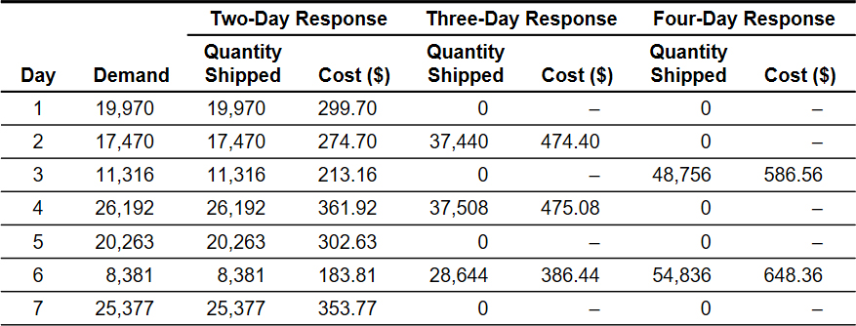
Trade-Off between Transportation Cost and Responsiveness (2 of 3)
Table 14-9 Quantity Shipped and Transportation Cost as a Function of Response Time

Slide 59
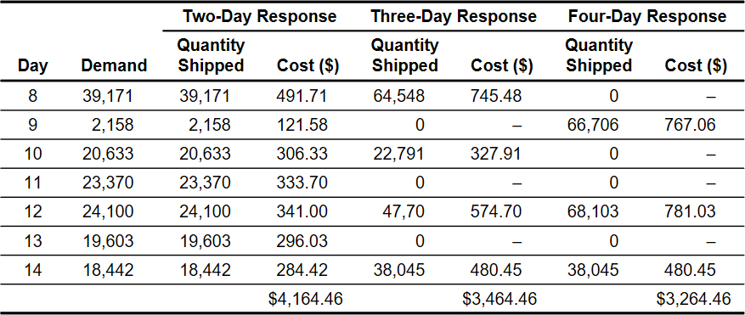
Trade-Off between Transportation Cost and Responsiveness (3 of 3)
Table 14-9 [continued]

Slide 60
Summary of Learning Objective 5 (1 of 2)
Given a supply chain goal to minimize the total cost while providing the desired level of responsiveness to customers, tradeoffs between transportation costs, inventory cost, facility costs, operating cost, and response time must be considered when selecting the mode of transport, the extent of inventory aggregation, and the targeted customer responsiveness. Modes with high transportation costs can be justified if they result in significantly lower inventory costs. Inventory aggregation decreases supply chain costs if the product has a high value-to-weight ratio, high demand uncertainty, low transportation cost, and customer orders are large.

Slide 61
Summary of Learning Objective 5 (2 of 2)
If a product has a low value-to-weight ratio, low demand uncertainty, large transportation cost, or small customer orders, inventory aggregation may increase supply chain costs. Temporal aggregation of demand reduces responsiveness but decreases transportation costs because it entails larger shipments and reduces the variation in shipment sizes from one shipment to the next. The marginal benefit of temporal aggregation declines as the time window over which aggregation takes place increases.

Slide 62
Tailored Transportation (1 of 3)
The use of different transportation networks and modes based on customer and product characteristics
Factors affecting tailoring
Customer density and distance
Customer size
Transportation cost based on total route distance
Delivery cost based on number of deliveries
Product demand and value

Slide 63
Tailored Transportation (2 of 3)
Table 14-10 Transportation Options Based on Customer Density and Distance
Blank | Short Distance | Medium Distance | Long Distance
High density | Private fleet with milk runs | Cross-dock with milk runs | Cross-dock with milk runs
Medium density | Third-party milk runs | L T L carrier | L T L or package carrier
Low density | Third-party milk runs or L T L carrier | L T L or package carrier | Package carrier

Slide 64
Tailored Transportation (3 of 3)
Table 14-11 Aggregation Strategies Based on Value/Demand
Product Type | High Value | Low Value
High demand | Disaggregate cycle inventory. Aggregate safety inventory. Inexpensive mode of transportation for replenishing cycle inventory and fast mode when using safety inventory. | Disaggregate all inventories and use inexpensive mode of transportation for replenishment.
Low demand | Aggregate all inventories. If needed, use fast mode of transportation for filling customer orders. | Aggregate only safety inventory. Use inexpensive mode of transportation for replenishing cycle inventory.

Slide 65
Summary of Learning Objective 6
Tailoring transportation based on customer density and distance, customer size, or product demand and value allows a supply chain to achieve appropriate responsiveness and low cost. Whereas a high density of customers close to a D C can be served by a private fleet, a low density of customers far from a D C may be better served using package carriers. Whereas large customers can easily be provided more frequent deliveries, doing the same for small customers is much more expensive. Whereas high demand, low value products should be decentralized to lower transportation costs, low demand, high value products should be centralized to lower inventory costs.

Slide 66

Copyright

